Slide 1
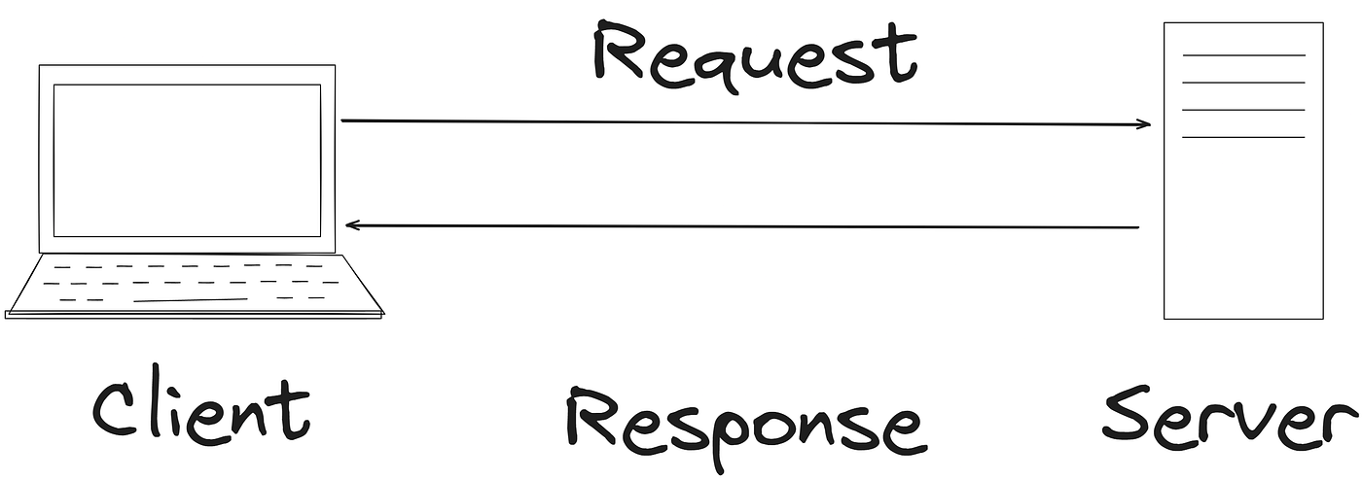
Client–Server Architecture

Slide 2
Client: The app you see and use (like your browser).
Server: A powerful computer that waits for requests.
Interaction: You (client) ask for something, the server does the work and sends back a response.

Slide 3
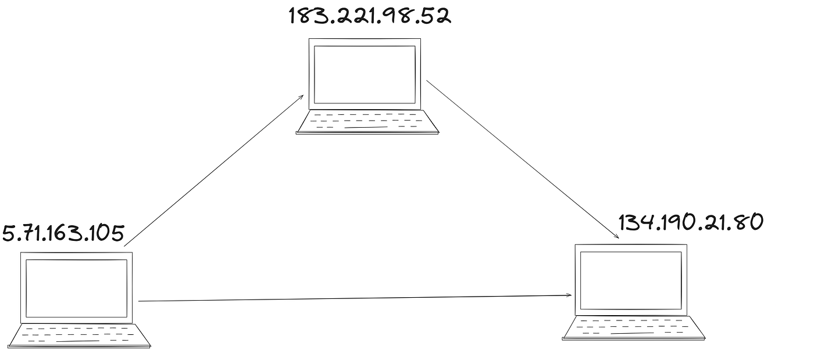
IP Address — The Internet’s Address Book

Slide 4
IP Address: A unique number for every device on the internet, like a computer's phone number.
Problem: Numbers are hard for people to remember.
Solution: DNS translates easy names (like google.com) into IP addresses for you.

Slide 5
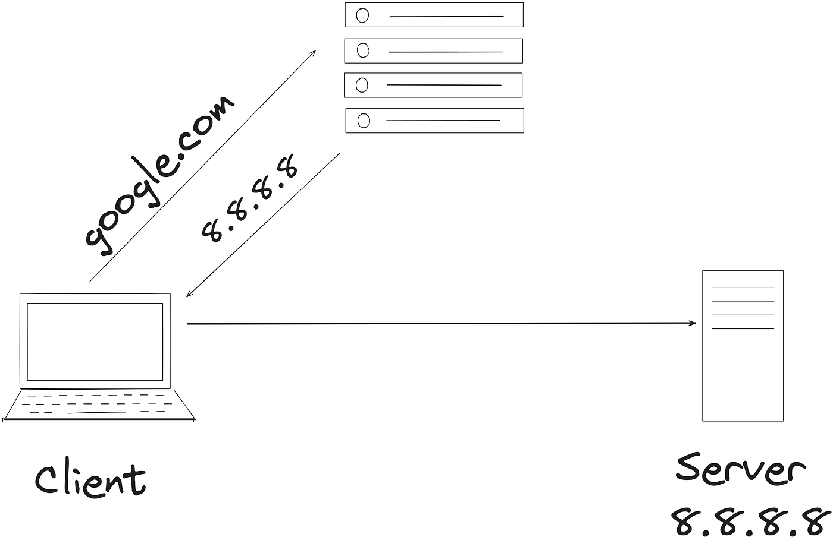
DNS — Mapping Names to Numbers

Slide 6
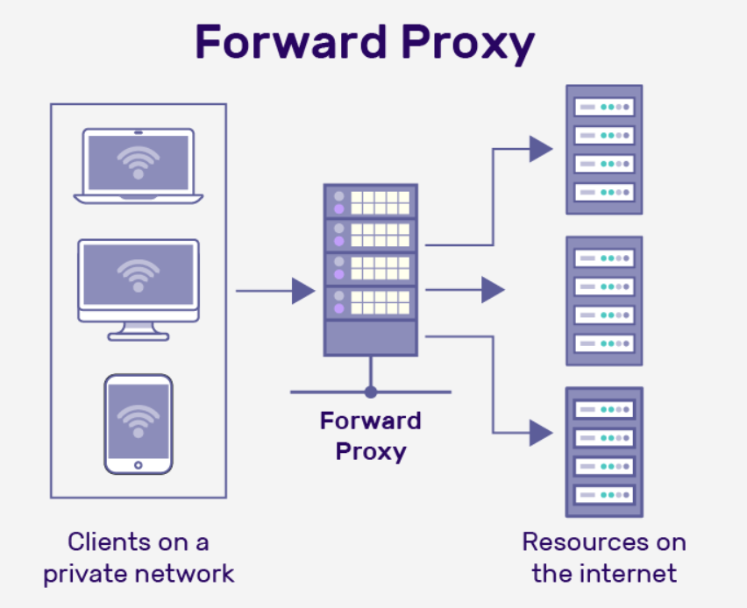
Proxy & Reverse Proxy — The Middlemen of the Web

Slide 7
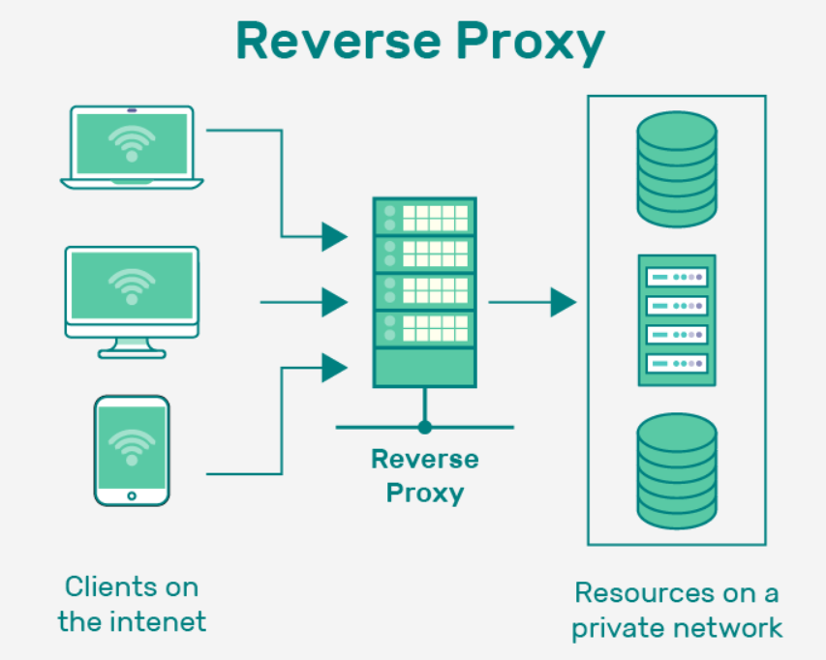

Slide 8
Proxy: Hides your identity when you talk to a server. (Good for your privacy).
Reverse Proxy: Protects the main server from the public internet.
They help with: Security, controlling traffic, and blocking bad requests.

Slide 9
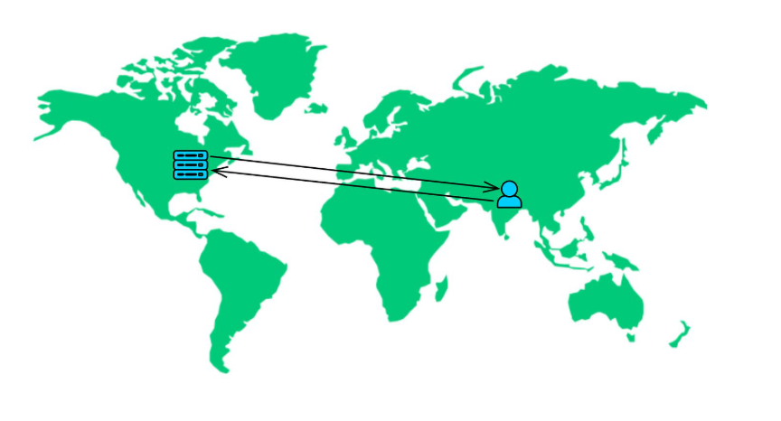
Latency — The Hidden Delay

Slide 10
The Problem of Latency
What it is: The delay when data travels between you and the server.
Main Cause: Physical distance.
Solution: Companies place servers all over the world, allowing you to connect to the closest one for faster speeds.

Slide 11
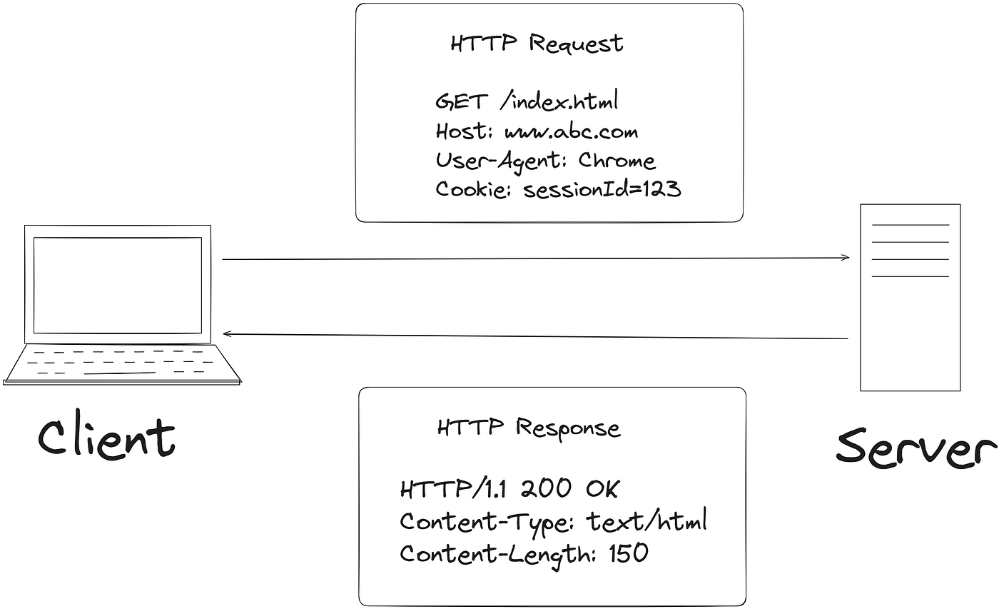
HTTP & HTTPS — The Language of the Web

Slide 12
HTTP: A set of rules for how browsers and servers talk.
Problem: HTTP sends data in plain text, which is unsafe.
HTTPS: The secure version. It encrypts the data so no one can read it in between.

Slide 13
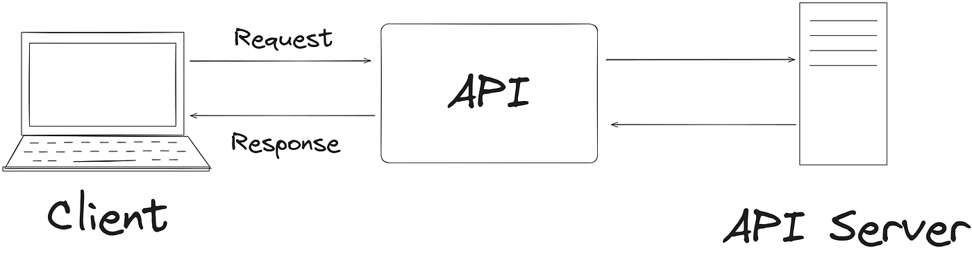
APIs — The Bridge Between Systems

Slide 14
What it is: A messenger that lets different apps talk to each other.
How it works: Your app sends a request to the API, the API talks to the server, and brings back the response.
Benefit: Your app doesn't need to know how the server works internally.

Slide 15
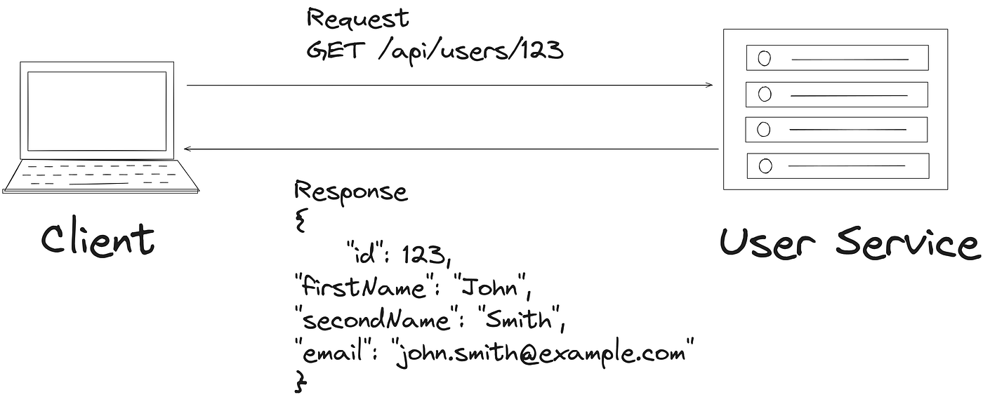
REST API — The Classic Standard

Slide 16
Simple Rules: Uses standard commands like:
  GET (Fetch)
  POST (Create)
  PUT/PATCH (Update)
  DELETE (Remove)
Everything is a Resource: Like /users or /products.
It's stateless: Every request is independent; the server doesn't remember you.

Slide 17
Stateless: Every Request is Independent
No Memory: The server does not remember anything about your previous requests.
Self-Contained: Each request you send must contain all the information the server needs to understand and fulfill it.
Like a Vending Machine: You put in money and press a button for one transaction. The machine doesn't remember you for the next transaction.

Slide 18
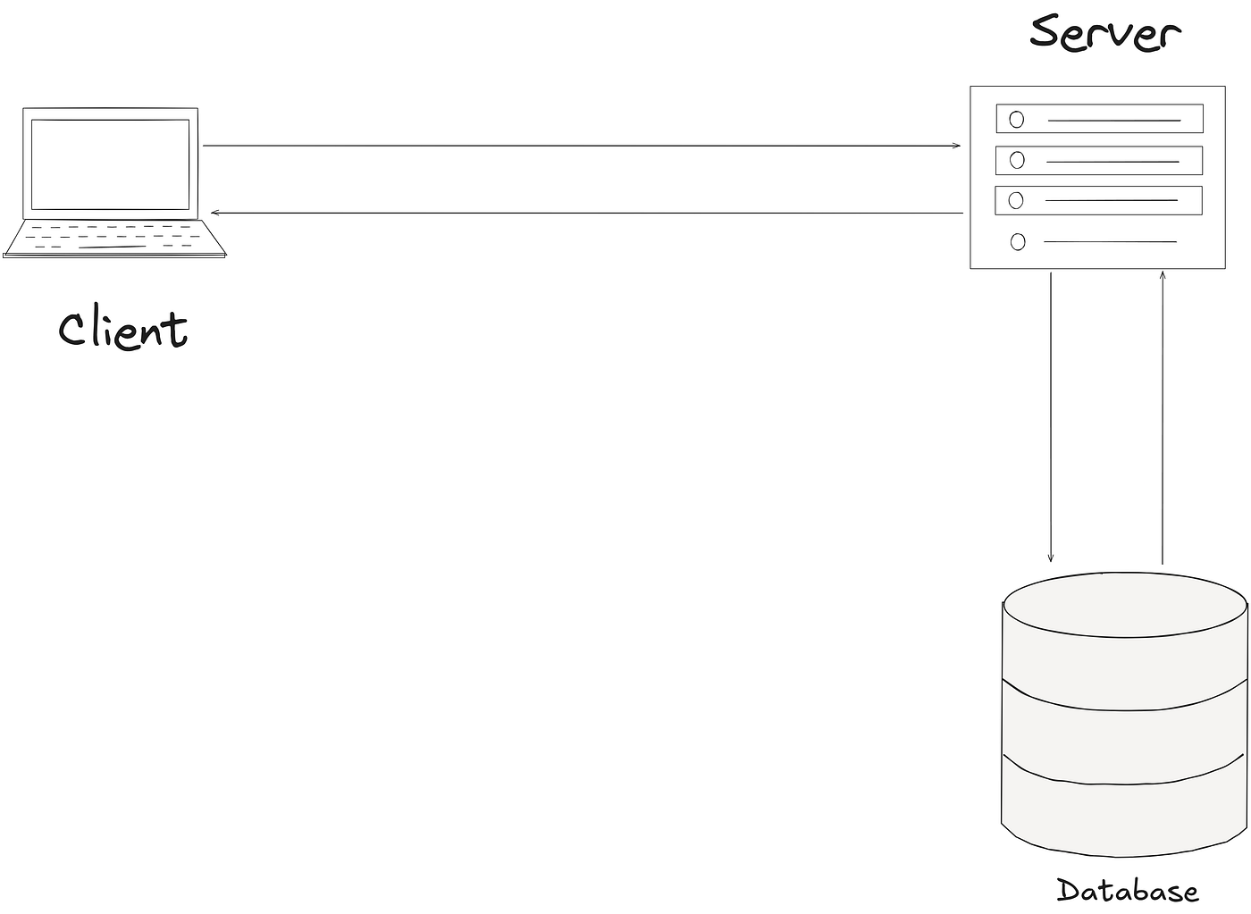
Databases — The Heart of Every System

